Slide 1
Pedestrian tracking
VUT FIT POVa
Lukáš Petrovič, Filip Šťastný, Martin Vondráček
2019-01-09

Slide 2
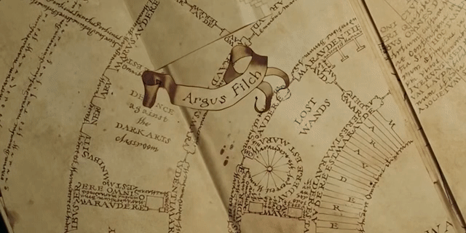
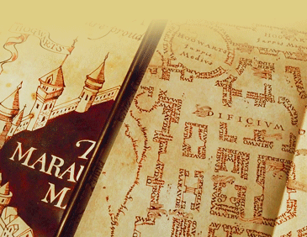
Task Inspiration
Marauder's Map from Harry Potter
Magic parchment that reveals the current location of anyone on Hogwarts grounds
http://harrypotter.wikia.com/wiki/Marauder%27s_Map

Slide 3
Task definition
Multiple people walking in a scene
Multiple stationary cameras
Initial calibration
Individual path tracking

Slide 4
Processing pipeline

Slide 5
Processing pipeline

Slide 6
Processing pipeline

Slide 7
Processing pipeline

Slide 8
Processing pipeline

Slide 9
Processing pipeline

Slide 10
Processing pipeline

Slide 11
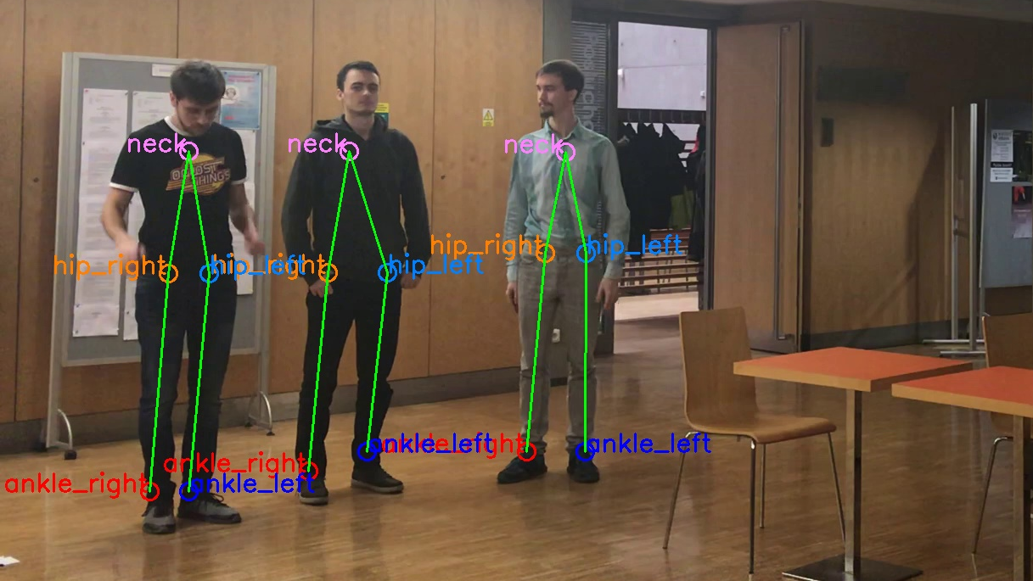
Human Detection in 2D
OpenPose deep neural network
Pretrained model with COCO dataset
Multi-person key point detection

Slide 12
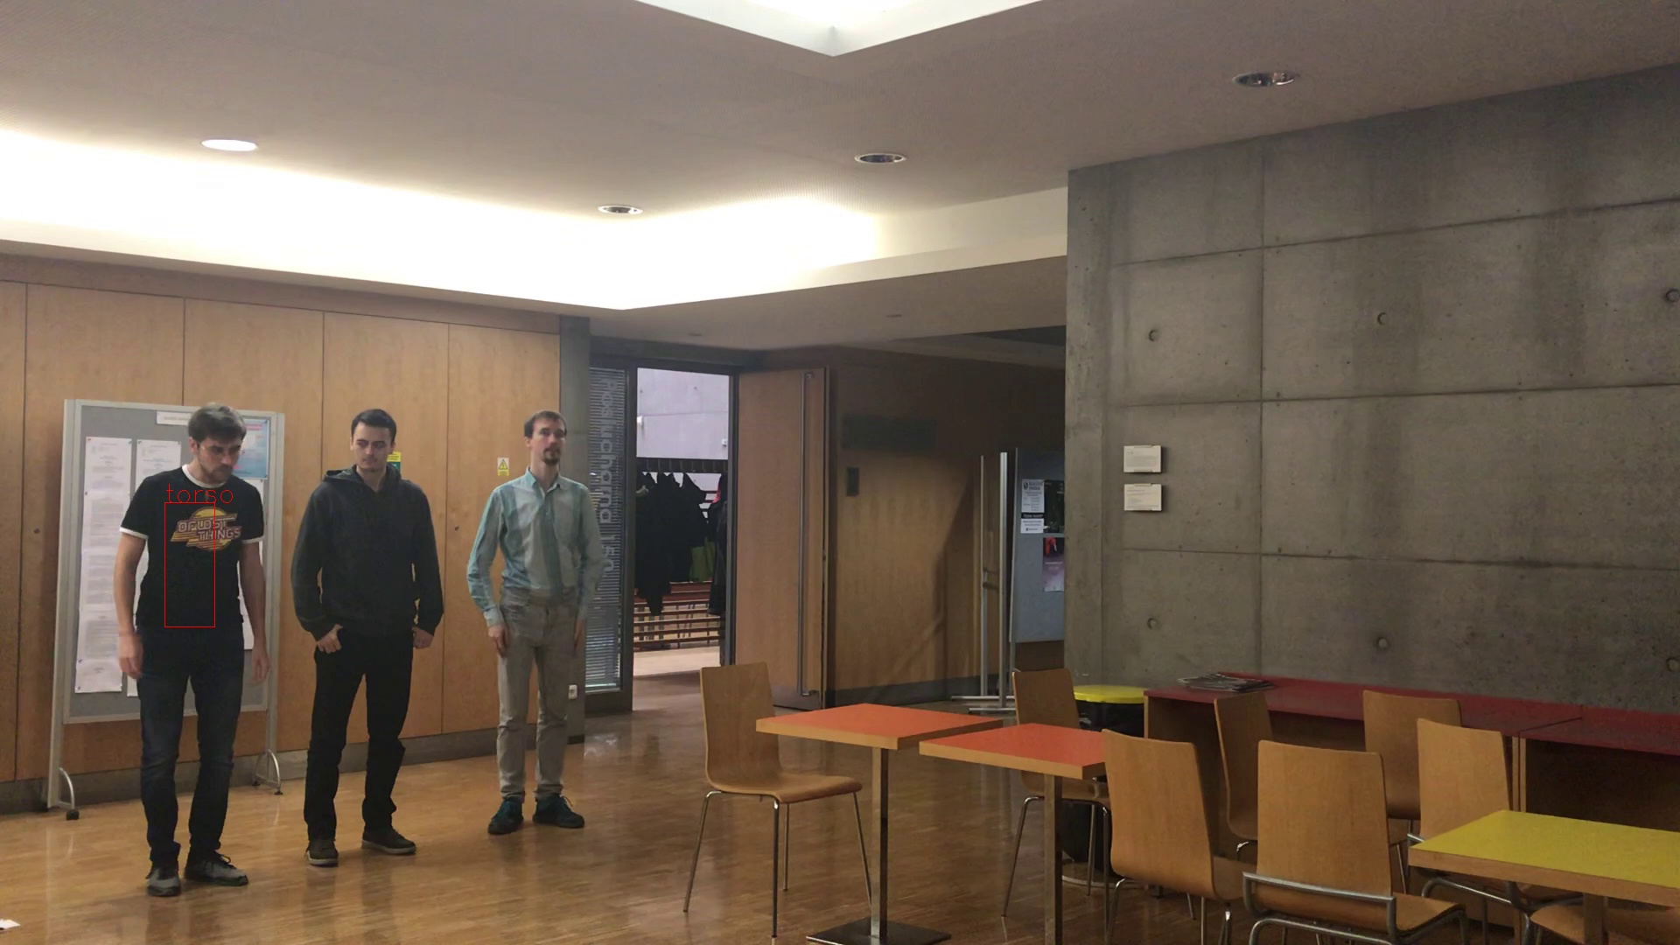
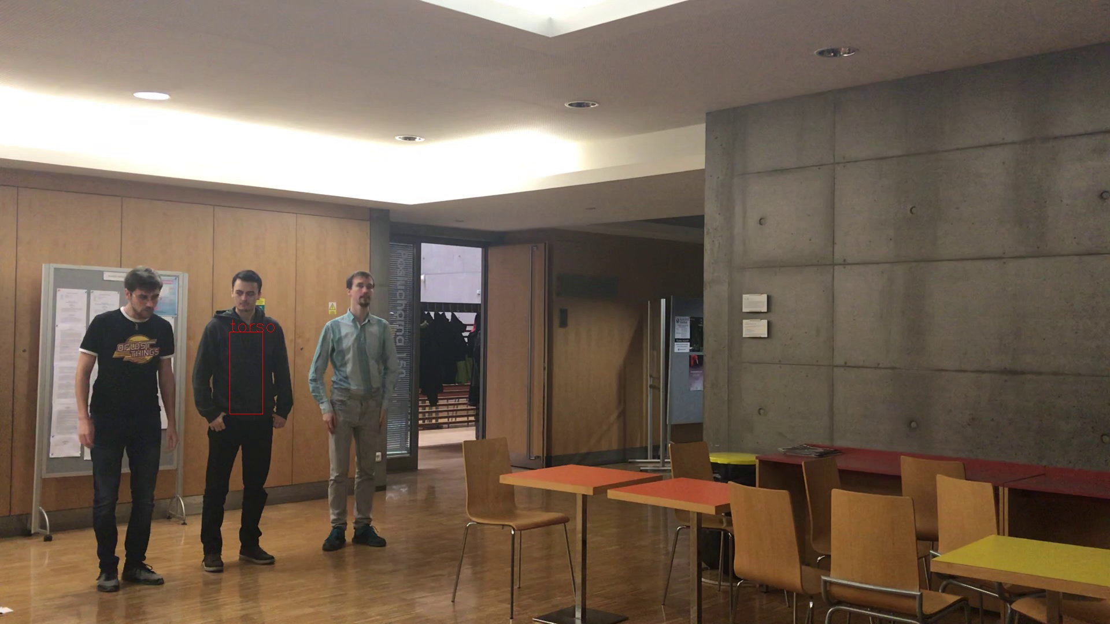

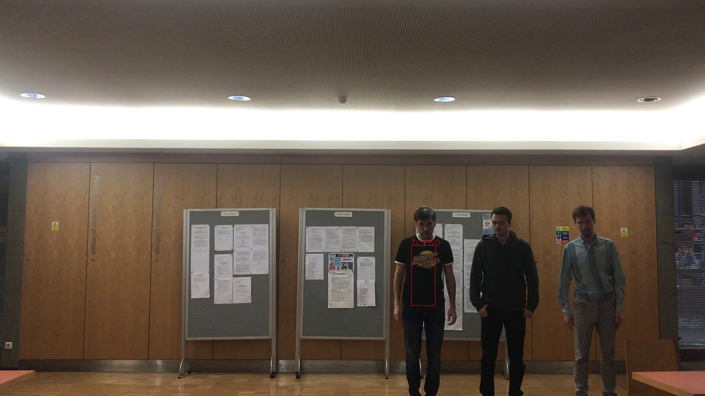


Person View Matching
Similar torso histograms → same person
Side person views
Front person views

Slide 13
Person View Matching
Similar torso histograms → same person
PersonTimeFrame A
PersonTimeFrame B
PersonTimeFrame C

Slide 14
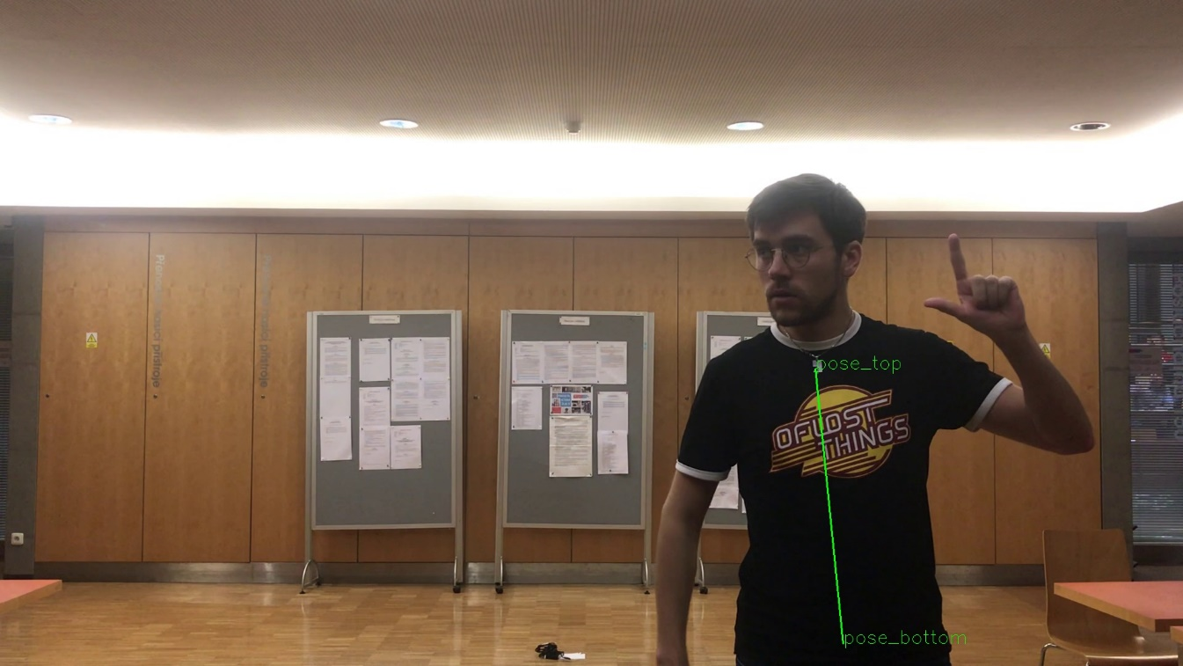
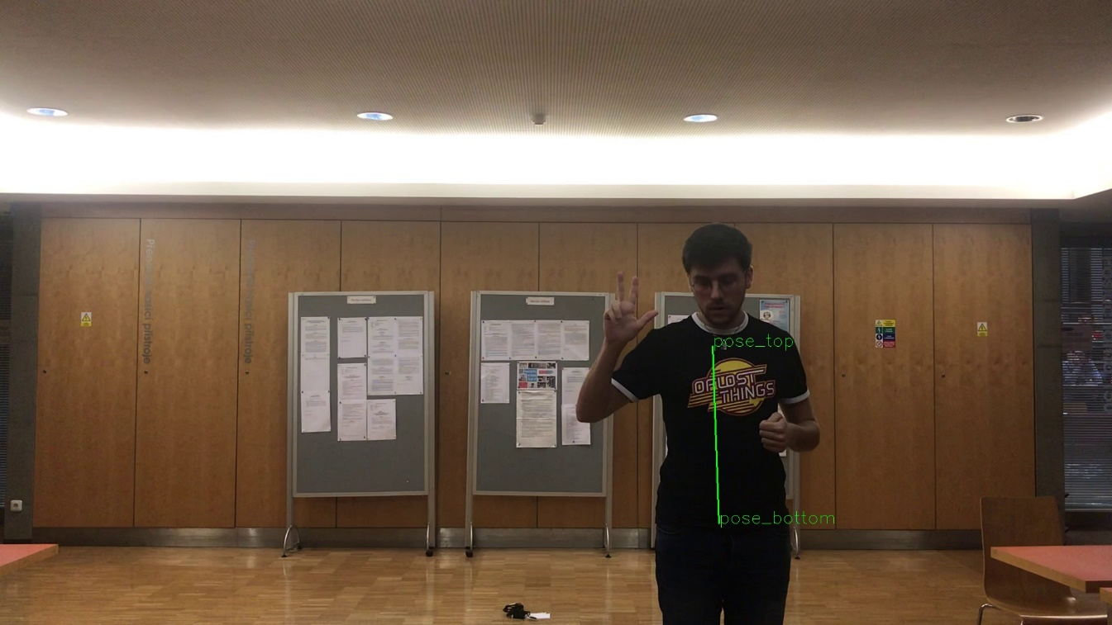
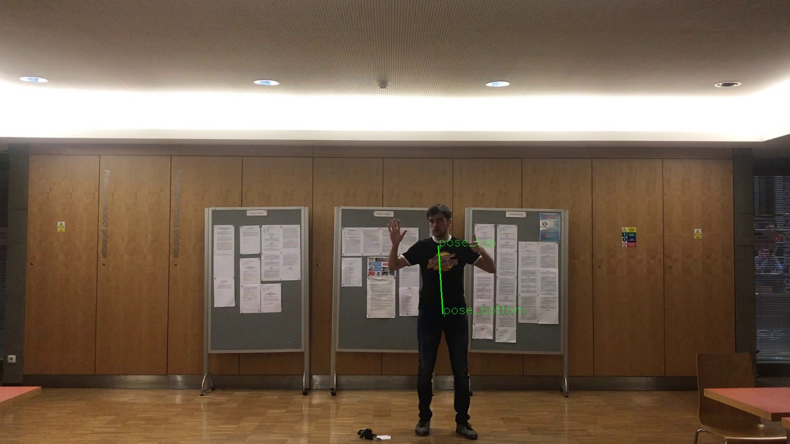
Triangulation
Average person’s torso → distance from camera
y = 2 m
y = 3 m
y = 6 m

Slide 15
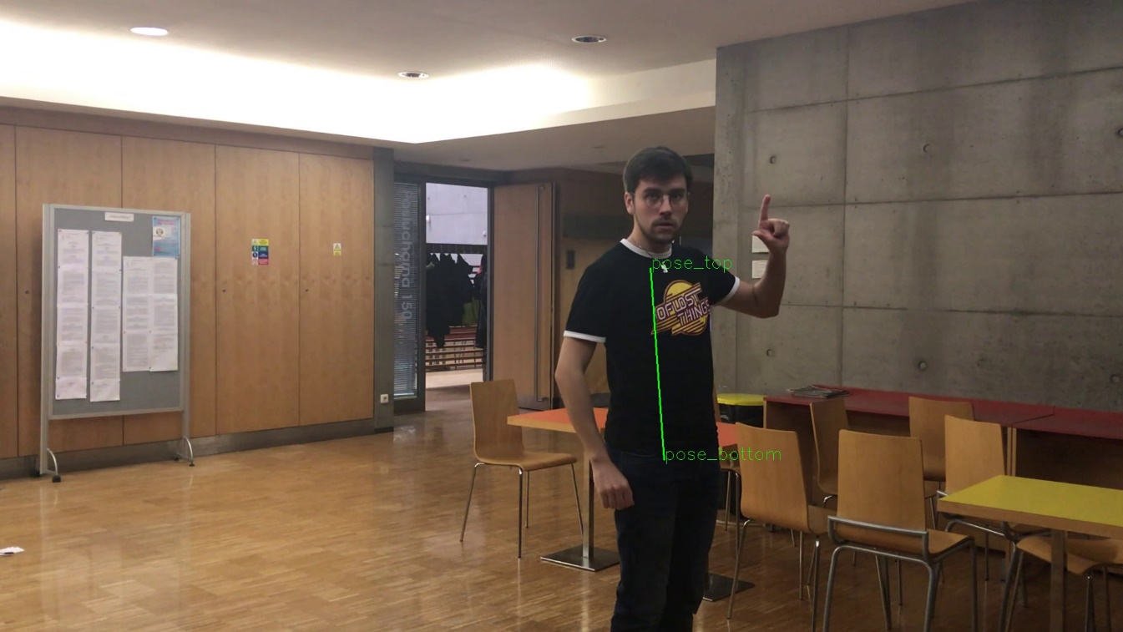
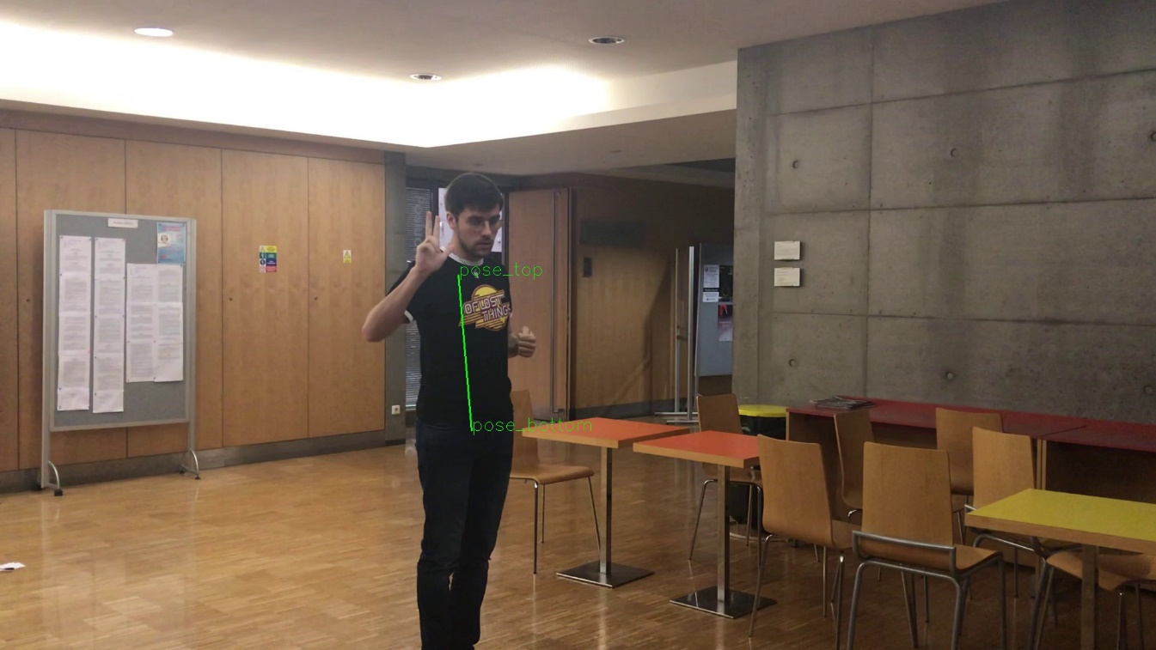
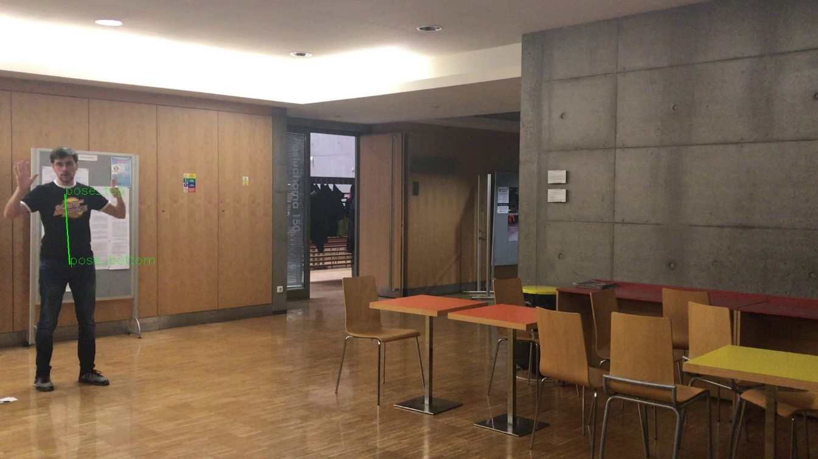
Triangulation
Average person’s torso → distance from camera
y = 2 m
y = 3 m
y = 6 m

Slide 16
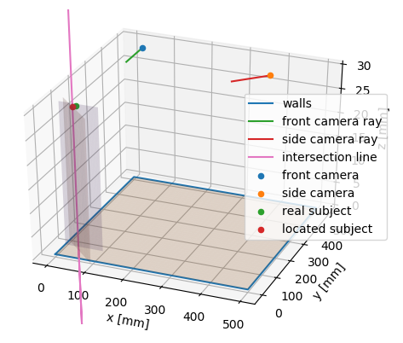
Triangulation
Intersection of distance planes → person‘s position

Slide 17
Person Tracking
Similar torso histograms over time → same person
Tracker

Slide 18
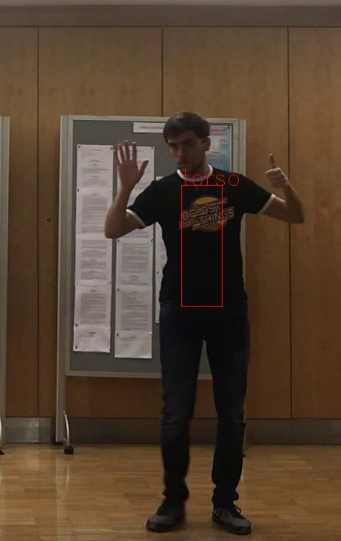
Person Tracking
Similar torso histograms over time → same person
Tracker

Slide 19

Person Tracking
Similar torso histograms over time → same person
New person!
Tracker
Person 1

Slide 20
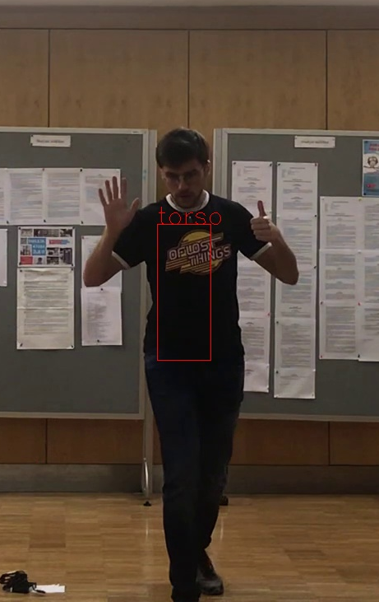
Person Tracking
Similar torso histograms over time → same person
Tracker
Person 1

Slide 21
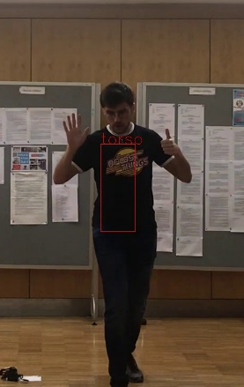
Person Tracking
Similar torso histograms over time → same person
Known person!
Tracker
Person 1

Slide 22
Person Tracking
Similar torso histograms over time → same person
Tracker
Person 1

Slide 23
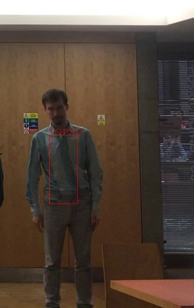
Person Tracking
Similar torso histograms over time → same person
New person!
Tracker
Person 1
Person 2

Slide 24
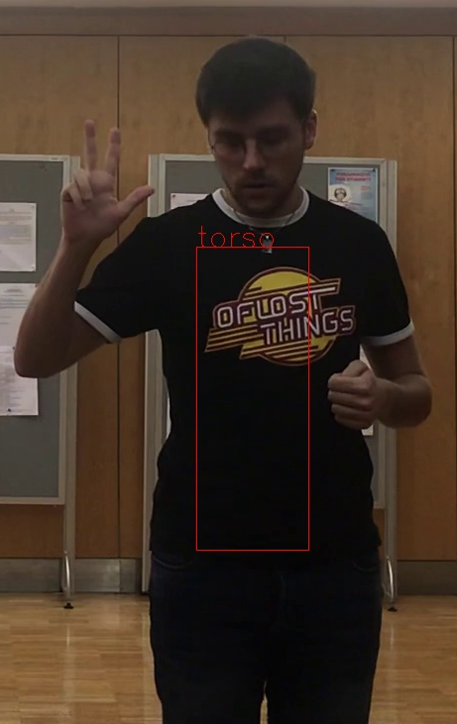
Person Tracking
Similar torso histograms over time → same person
Tracker
Person 1
Person 2

Slide 25

Person Tracking
Similar torso histograms over time → same person
Known person!
Tracker
Person 1
Person 2

Slide 26
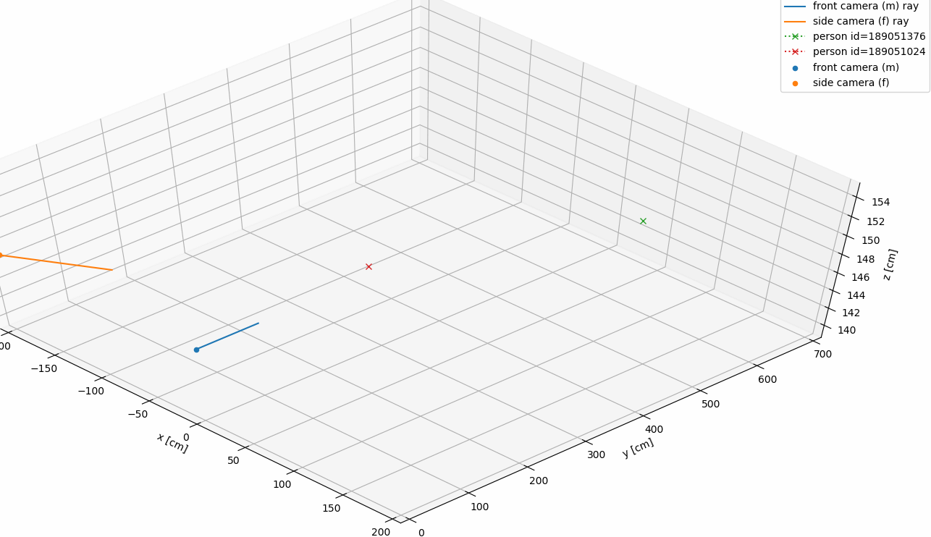
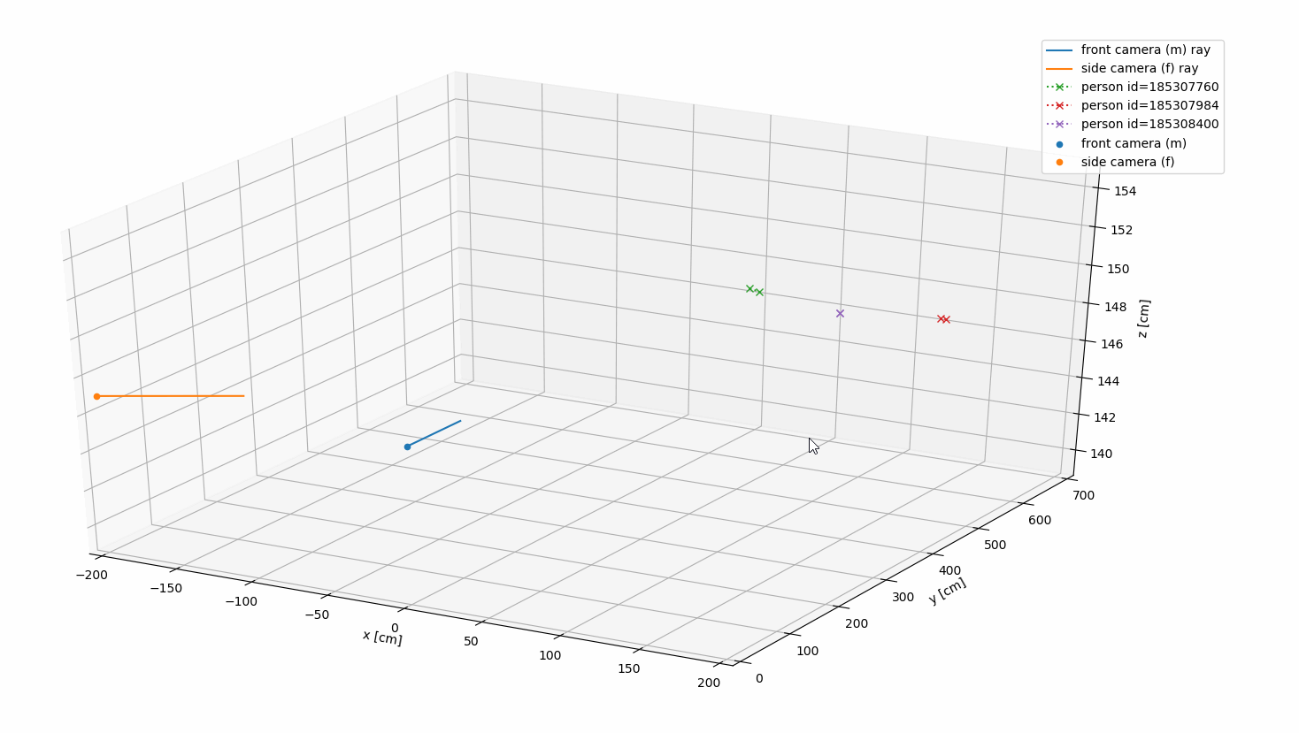
Visualisation
Paths of all tracked people, positions of cameras
Interactive 3D model

Slide 27
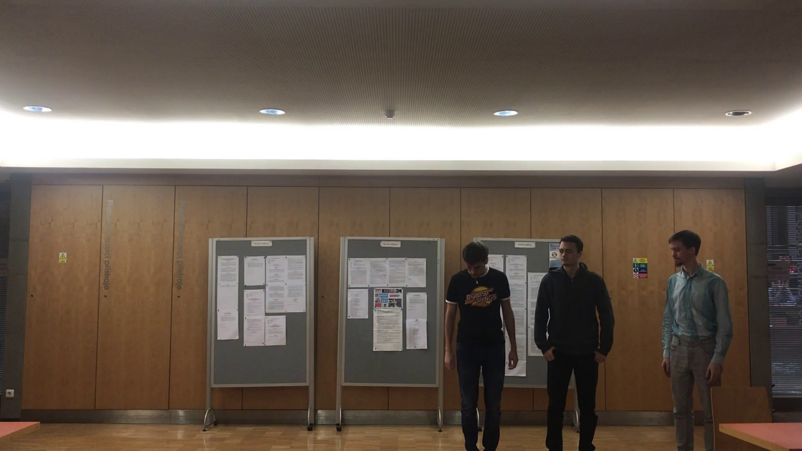
Testing Data
Own images and videos
COCO dataset for OpenPose

Slide 28
Evaluation

Slide 29
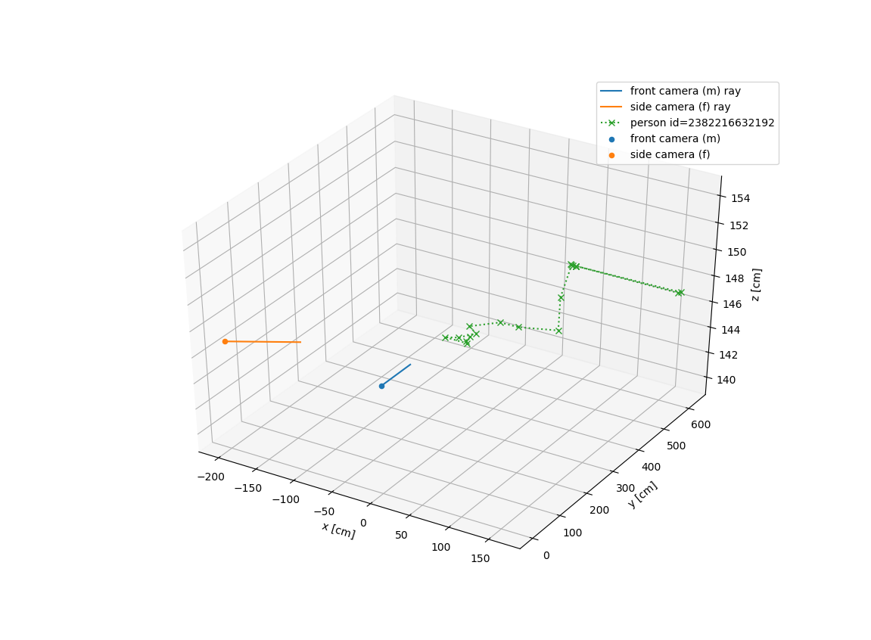
Evaluation
Matching
Triangulation worst case less than 35 cm error in 600 cm space.
Tracking Similarity threshold

Slide 30
Thank you for your attention.
Pedestrian tracking

